Slide 1
Link-Level Flow Control and Buffering
Driving Innovations™
James
2020-04-24

Slide 2
Outline
Valid/ready Flow Control
Half-Bandwidth Elastic Buffer
Full-Bandwidth 2-Slot Elastic Buffer
Credit-Based Flow Control
Req/ack Flow Control
Microarchitecture of Network-on-Chip Routers

Slide 3
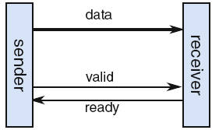
Valid/ready Flow Control
Valid:
When the sender wants to put new data on the link it asserts the valid signal. The receiver samples new data from the link only when it sees.
Ready:
Receiver is ready to get new data.
Transfer (valid=1/ready=1):
Sender is providing valid data and the receiver is accepting them.
Idle (valid=0):
Sender is not providing any valid data, irrespective the value of the ready signal.
Wait (valid=1/ready=0):
Sender is providing data but the receiver is not able to accept it. The sender should maintain the valid data until the receiver is able to read them.

Slide 4
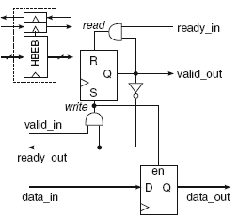
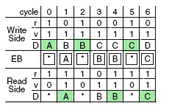
Half-Bandwidth Elastic Buffer
Push or a pop to take place in each cycle, and never both.
50% throughput.
Assume that set (write) has the highest priority.

Slide 5
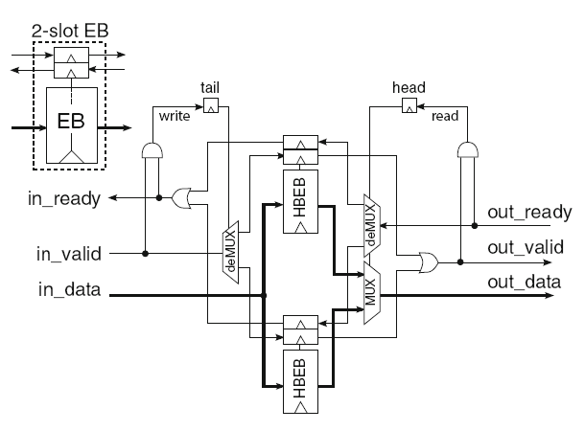
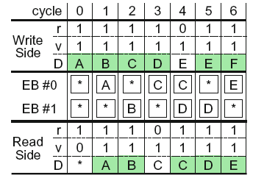
Full-Bandwidth 2-Slot Elastic Buffer
100% throughput of operation.
Fully isolates the timing paths between the input and output handshake signals.

Slide 6
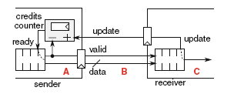
Credit-Based Flow Control
Credits counter is attached to the sender.
Sender keeps track of the available buffer slots of the receiver.
Credit counter is decremented at each new transmission(valid).
Credit counter is increased when one word is consumed at the receive (update).
Credit >0 :
Receiver is available.
Sender is allowed to send a new word.
Credit = 0:
Receiver is not available.
Sender should stall a transmission.
Credit = 0*:
It is simultaneously incremented due to credit update and decremented due to the transmission of a new word.

Slide 7
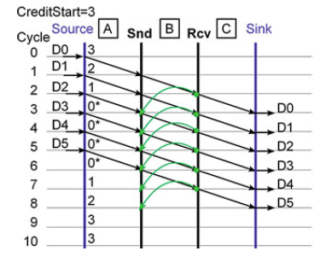
Credit-Based Flow Control
An example of data transfers on a link between a sender and a receiver governed by credit-based flow control.

Slide 8
Request–Acknowledge Flow Control
With req/ack protocol the sender is not aware of receiver’s buffer status as done in ready/valid or credit-based flow control protocols.
Every issued request is always meaning “data are sent”. The sender after issuing a request has two choices:
Wait for an ack, possibly arriving in the next cycles, before placing next available data on the channel. (50% throughput)
Send new data and manage possible nacks as they arrive.

Slide 9
Request–Acknowledge Flow Control
Cycle 2:
Complete the D2 transmission.
Send D3 from sender.
Cycle 3:
no ack has returned the sender prepares a new word to put on the channel.
D3 is not erased but it is put on hold in an auxiliary buffer.
Cycle 4:
Receiver acknowledges the receipt of data.
D3 in the auxiliary buffer is erased and replaced by the current data on the channel.
D3
buffer

Slide 10
Request–Acknowledge Flow Control
Cycle 2:
Complete the D2 transmission.
Send D3 from sender.
Cycle 3:
no ack has returned the sender prepares a new word to put on the channel.
D3 is not erased but it is put on hold in an auxiliary buffer.
Cycle 4:
Receiver doesn’t acknowledge the receipt of data.
Receiver was stalled and stops transmission.
It continues trying to send its data but now sends first the data in the auxiliary buffer that have not been acknowledged yet by the receiver and delays the propagation of new data.
D4
D3
buffer

Slide 11
Thank You!

Slide 12

Thank You!
www.andestech.com

Slide 13
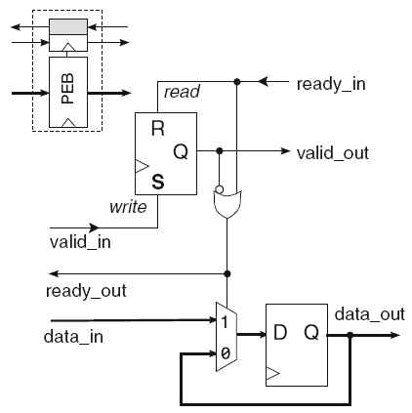
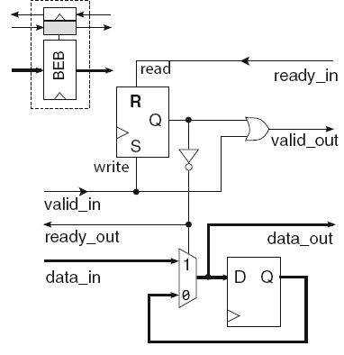
Alternative Full-Throughput Elastic Buffers
The pipelined EB that offers full throughput of data transfer and introduces direct combinational paths between ready_in and ready_out backward notification signals.
The bypass EB that offers full throughput of data transfer and introduces direct combinational paths between data_in (valid_in) and data_out (valid_out) forward signals

Slide 14
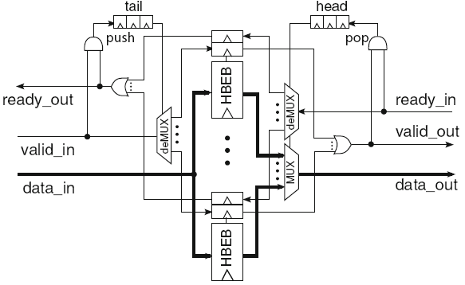
Generic FIFO Queues
When new data are pushed in the FIFO, they are written in the position indexed by the tail pointer; in the same cycle the tail pointer is increased (modulo the size of the FIFO buffer) pointing to the next available buffer.

